Slide 1
Computer Organization
Basic Concepts
by Akkradach W.
Dept. of Computer Engineering
KMITL

Slide 2
Agenda
Computing Layers
Binary Data Representation
Integer Arithmetic
Boolean Operations
Extras

Slide 3
Computing Layers
High-Level Language
Assembly Language
Machine Code (ISA)
Microarchitecture
(Digital) Logic Gates

Slide 4
High-Level Languages
Interpreted Languages
  Python, Ruby, JavaScript, PHP, …
Compiled Languages
  C/C++, Pascal, Go, …
Hybrid Languages
  Java, Scala, C#, …

Slide 5
Interpreted Languages
Interpreting
Read a line
Do a line

Slide 6
Compiled Languages
Source Codes
(.c)
Object Codes
(.obj)
Machine Code
(.exe)
Compiler
Linker

Slide 7
Hybrid Languages
Source Codes
(.java)
bytecode
OR
p-code
JVM
OR
.NET
Just-In-Time
Compiler

Slide 8
Example : C to ASM
int add(int a, int b)
{
return a + b;
}
add(int, int):
push rbp
mov rbp, rsp
; Register passing (EDI, ESI)
mov DWORD PTR [rbp-4], edi
mov DWORD PTR [rbp-8], esi
; Pull from stack
mov edx, DWORD PTR [rbp-4]
mov eax, DWORD PTR [rbp-8]
; Do addition
add eax, edx
; Register returning (EAX)
pop rbp
ret

Slide 9
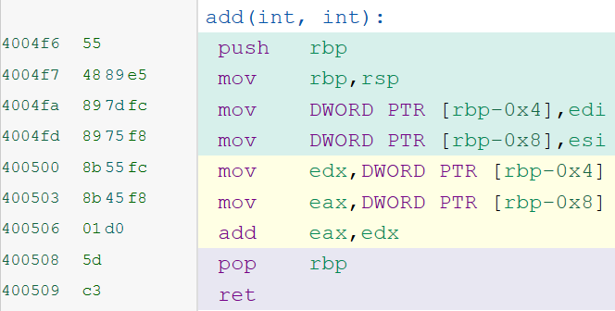
Example : Machine Code
Addr
Code
gcc 6.3 (x64) from https://godbolt.org/

Slide 10
Microarchitecture (naïve)

Slide 11
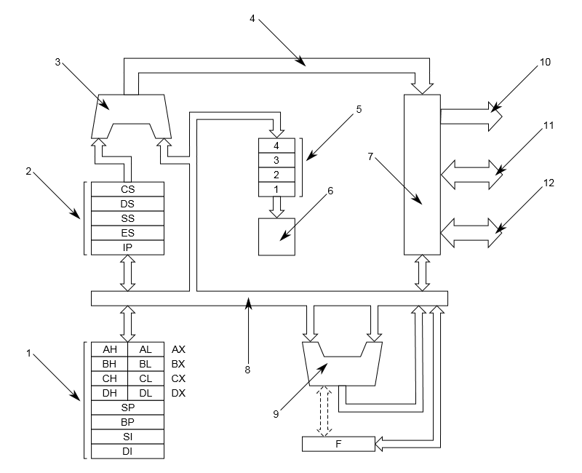
8086/8088 Block Diagram
main registers
segment registers and IP
address adder
internal address bus
instruction queue
control unit
bus interface
internal databus
ALU
10/11/12) external address/data/control bus.
From Wikipedia.org

Slide 12
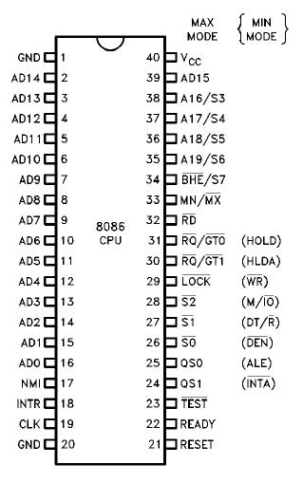
8086 Pins
From Wikipedia.org

Slide 13
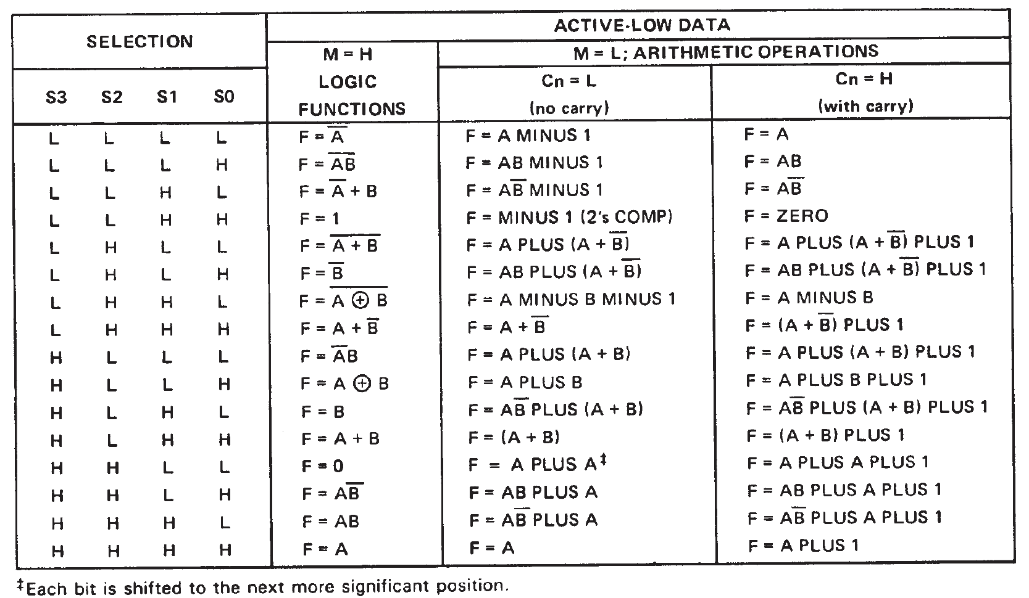
ALU Operations : SN74S181

Slide 14
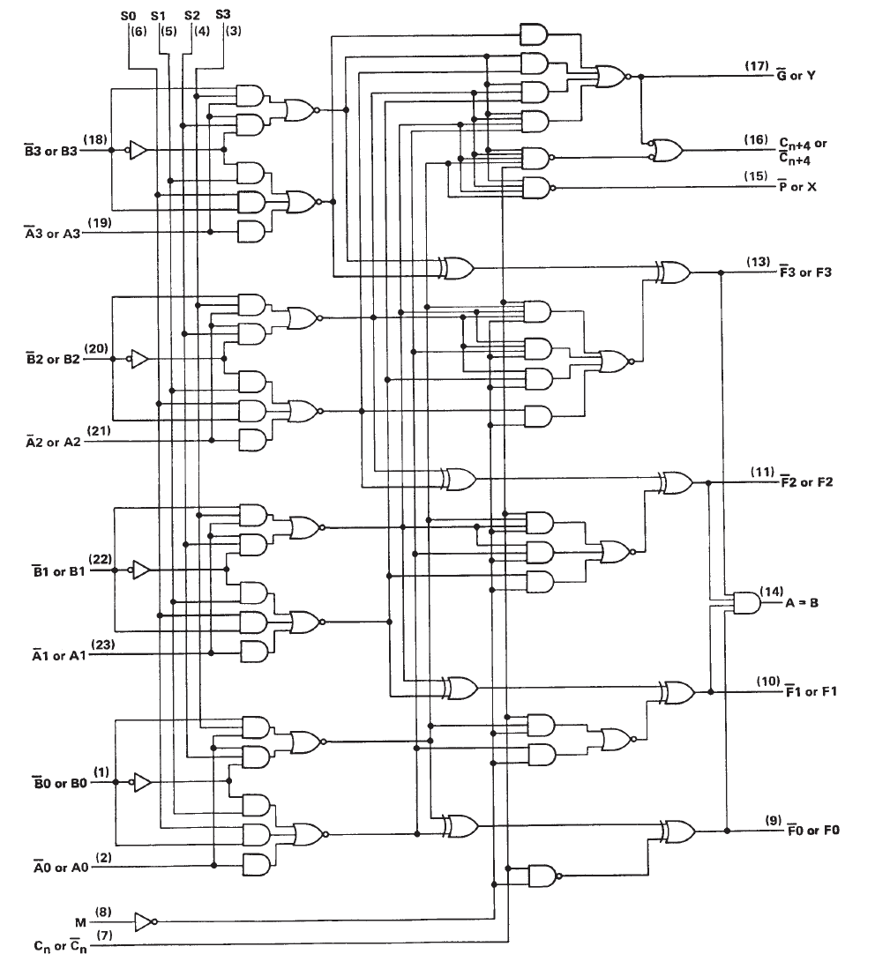

Slide 15
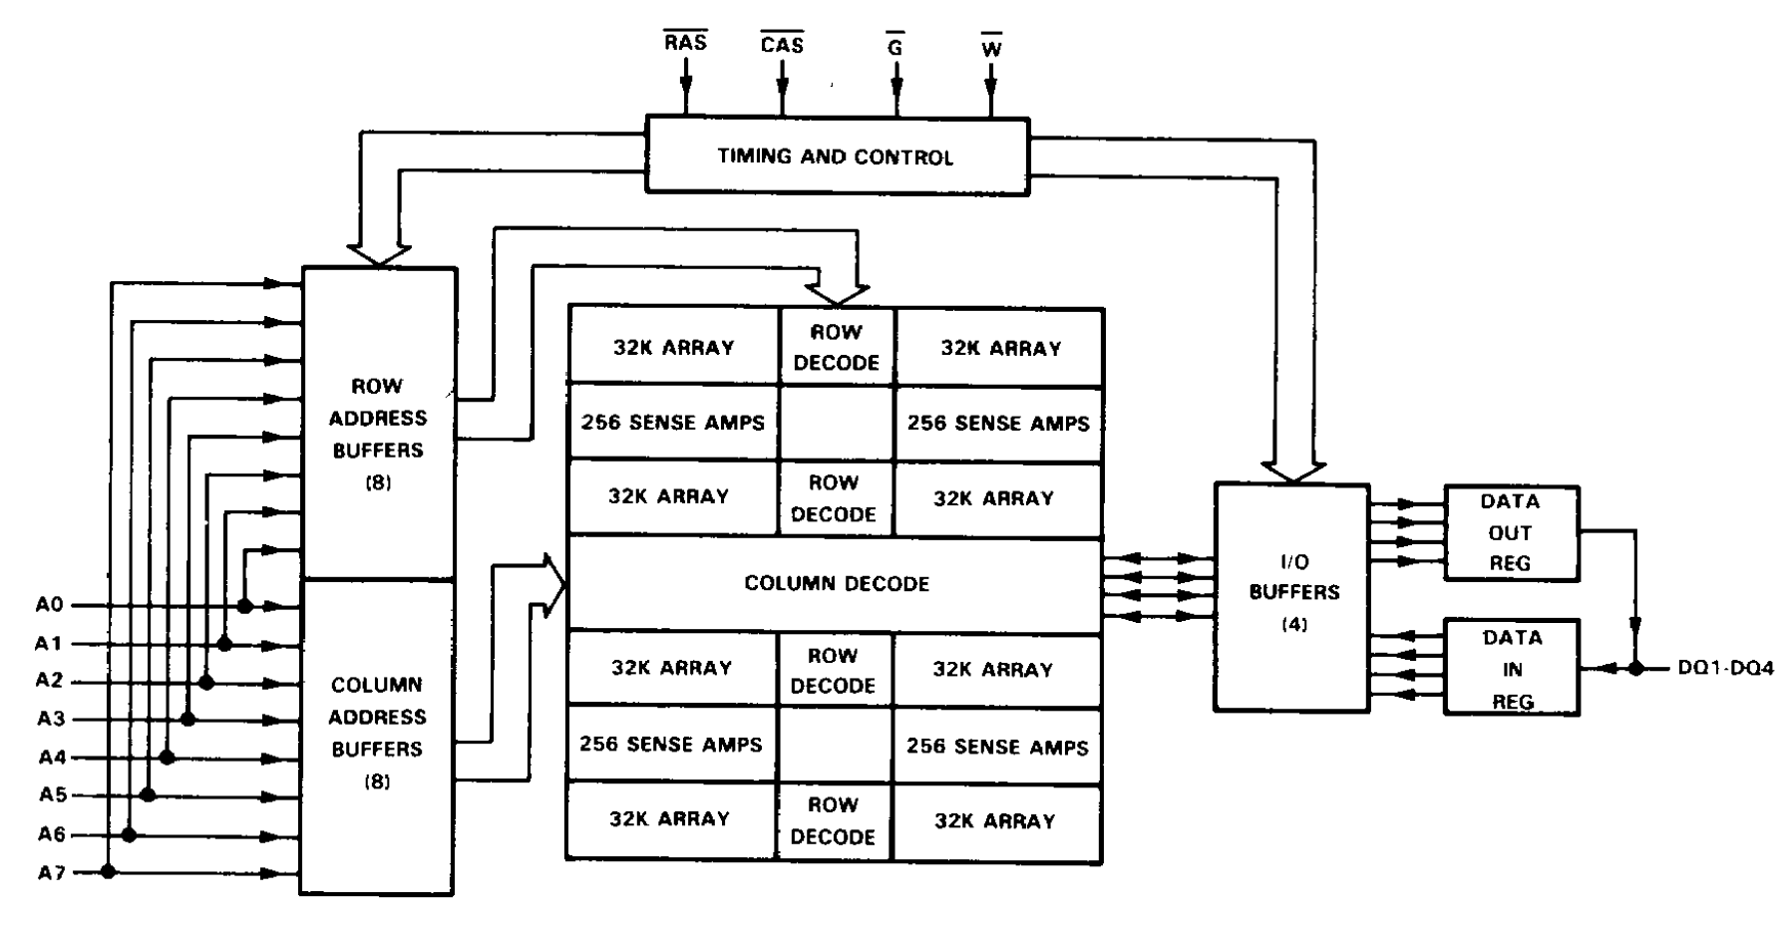
RAM Operations : SMJ4464

Slide 16
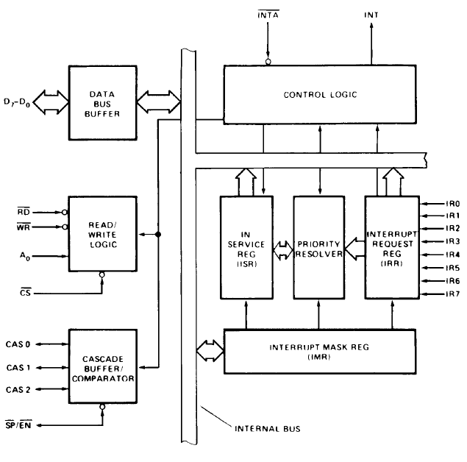
Interrupt Controller : 8259A

Slide 17
Binary Data Representation
Character Encoding
  ASCII (7-bit char)
  ANSI, ISO/IEC 8859 (8-bit char)
    ISO/IEC 8859-11 ≡ TIS-620
  UTF-16 (16-bit Unicode char)
Binary Numbers
  Integer : Unsigned VS Signed
    BIN, OCT, HEX
  Real : Fixed-Point VS Floating-Point

Slide 18
Size of C stuffs (bytes)
C Data Type | x86 (32-bit) | x64 (64-bit)
unsigned | 4 | 4
int | 4 | 4
long int | 4 | 4
char | 1 | 1
short | 2 | 2
float | 4 | 4
double | 8 | 8
void * | 4 | 8

Slide 19
Signed Integer Forms
Sign Bit
  MSB = 0 Positive ones
  MSB = 1 Negative ones
  Has two zeros { +0, -0 }
Two’s Complement
  Has sign bit
  Negative ones must NOT then +1
    (-2) → 00000010 → 11111101 → 11111110
      FYI : 00000001 + 11111111 = 00000000 (no Carry)

Slide 20
ASM (x86) Data Units
A byte (8 bits)
  db 41h
  db ‘A’
  db ?
A word (16 bits)
  dw 1234h
  db 34h, 12h
  db ‘ab’
A double word (32 bits)
  dd 12345678h
  db 78h, 56h, 34h, 12h
  db ‘abcd’

Slide 21
Integer Byte Ordering
Big Endian : Others
  Least significant byte has highest address
Little Endian : Intel (x86, x64)
  Least significant byte has lowest address
ADDR | Big | Little
0100h | 01 | 67
0101h | 23 | 45
0102h | 45 | 23
0103h | 67 | 01
To store 0x01234567

Slide 22
Integer Arithmetic
Addition
  with OR without Carry?
  Signed with Overflow?
Subtraction
  Add with 2’s
  a - b ≠ b - a
Multiplication
  Shift-Add OR Multi-Adder circuit
  8-bit x 8-bit → 16-bit
Division
  Dividend = Quotient x Divisor + Remainder
  Divided by Zero!

Slide 23
String Representations
C : char tmp = “1234Aa$”;
  1, 2, 3, 4, A, a, $, \0
  0x31, 0x32, 0x33, 0x34, 0x41, 0x61, 0x24, 0x00
ASM : tmp db “1234Aa$”
  1, 2, 3, 4, A, a, $
  31h, 32h, 33h, 34h, 41h, 61h, 24h
UNIX : \n ≡ DOS : CR+LF

Slide 24
Boolean Operations
NOT, AND, OR
XOR, NAND, NOR
Logical VS Binary Operator
  if ((x<y) & (y<z)) …
  if ((x<y) && (y<z)) …
  if (!x) …

Slide 25
Extras
Example Codes
  Hello.ASM
  INT10h.ASM
  VRAM.ASM

